Slide 1
Getting Started……………………………………..…
page 01
The Request Process………………………………..
page 02
Create a Request………………………..…
page 03
View Active Requests……………………
page 04
View Completed Requests…………….
page 05
View Scholar Spending……………………………
page 06
Input Expenses…………………………………..……
page 07
View Cash Flow…………………………………….…
page 08
REAL LIFE COORDINATION SYSTEM
Getting Additional Help……………………..……
page 09
User Manual
For Area Coordinators
“We don’t think you need a manual, but just in case…”

Slide 2

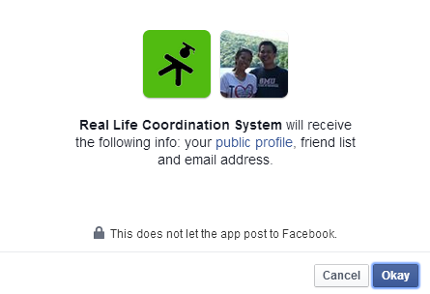

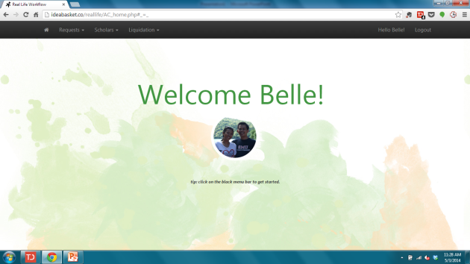
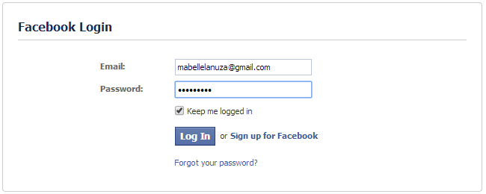
Getting Started
1
Open your browser, and go to http://igivetolife.com/request
4
You will see this screen, click “Okay”.
2
Click “Login with Facebook”
5
Congratulations! You are now logged in.
3
Enter your Facebook login details and click “Log In”

Slide 3
How the Request Process works:
Area Coordinator Tasks
Real Life Staff Tasks
AC (Area Coordinator) submits a funding request via the system. AC can see the request as an ‘Open’ request.
RLS (Real Life Staff) decides whether to ‘Approve’ or ‘Reject’ the ‘Open’ request from AC. This is done every Tuesday noon.
Step AC01
Step RLS01
reject
approve
AC sees the request as ‘Rejected’, with the reason for rejection from Real Life Staff. AC marks ticket as ‘Completed’
Real Life Staff marks request as ‘Rejected’
Real Life Staff marks Request as Approved
Step AC02
Real Life Staff generates a file for EN Finance Dept.
Step RLS02
Both Area Coordinator and Real Life Staff can see the request with status ‘COMPLETED’.
Step AC03
Step RLS03

Slide 4
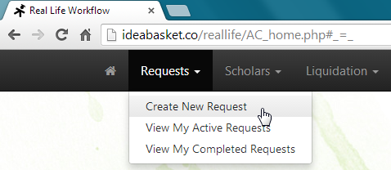
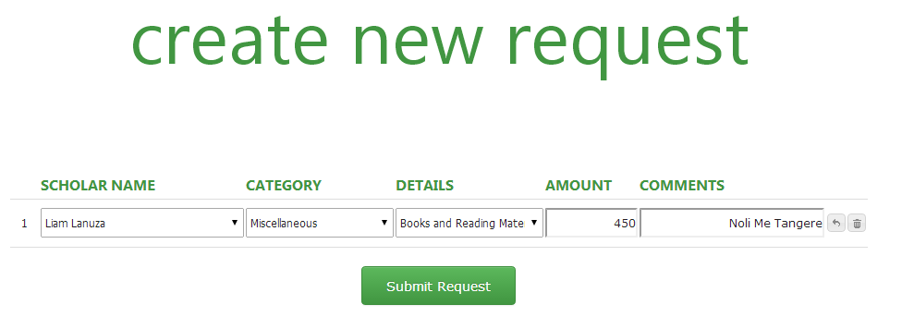
Step AC01: Create a Request:
1
Using the top menu, click ‘Requests’ → ‘Create New Request’
2
Select ‘Scholar Name’, ‘Category’ and ‘Details’ from the selections available. Type in the Amount Requested and any other comments to help Real Life Staff decide.
Once done, click ‘Submit Request’. (Hint: You can make multiple requests by clicking on the arrow icon on the right side to add new lines.)

Slide 5
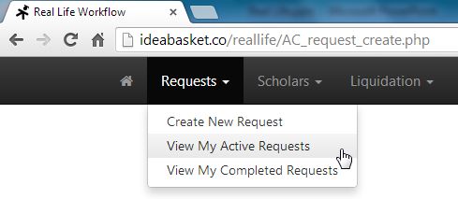
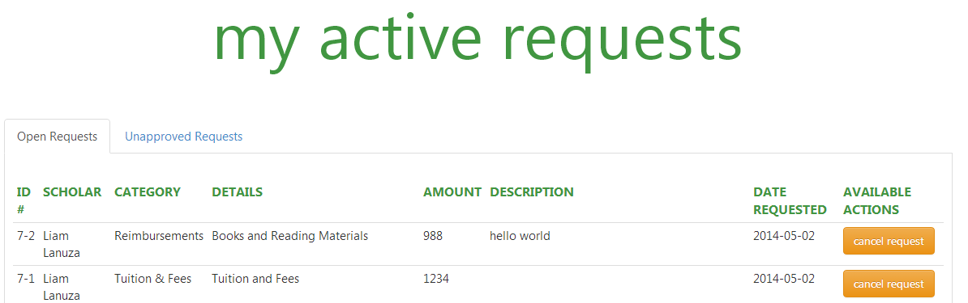
Step AC02: View Open or Rejected Requests:
1
Using the top menu, click ‘Requests’ → ‘View My Active Requests’
2
Click on the tab ‘Open Requests’ to view the requests that are waiting for approval from Real Life Staff. You can still cancel these tickets.
Click on the tab ‘ Unapproved requests’ to view your Rejected requests. Once you have seen rejected tickets and why they were rejected, you can ‘complete’ the request.

Slide 6
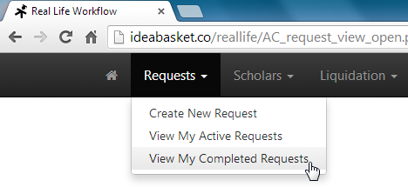
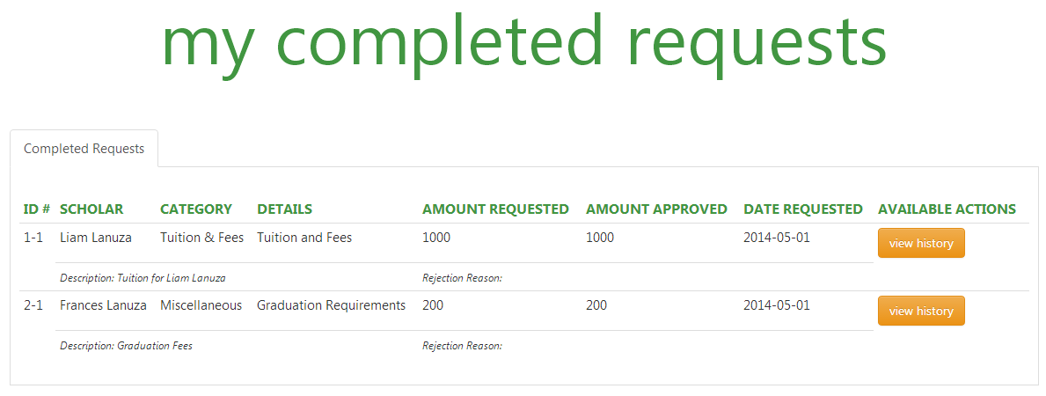
Step AC03: View Completed Requests:
1
Using the top menu, click ‘Requests’ → ‘View My Completed Requests’
2
Click on the tab ‘Completed Requests’ to view the requests that have gone thru full processing. You can view its history by clicking on the ‘View History’ button.

Slide 7
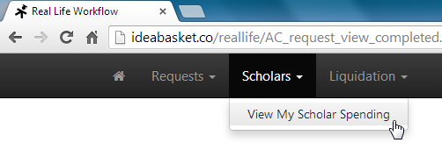
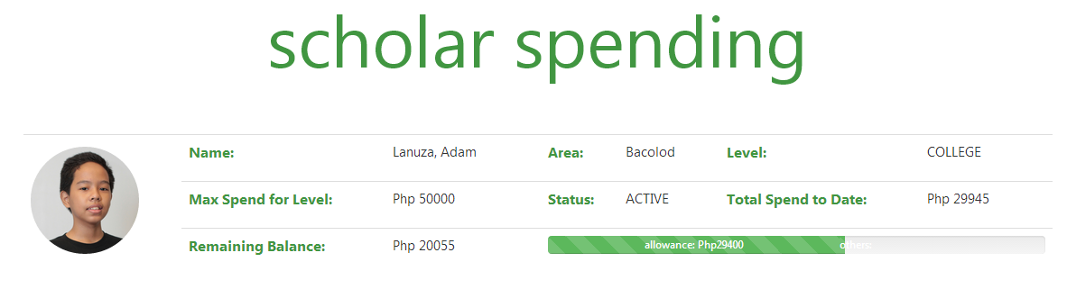
View Scholar Spending:
1
Using the top menu, click ‘Scholars’ → ‘View My Scholar Spending’
2
A listing of your scholars will be shown – with data on their spending levels. A green bar (like below) means spending levels are in good shape. Yellow/Red bars will be
shown if the spending levels are near or over the threshold already.

Slide 8
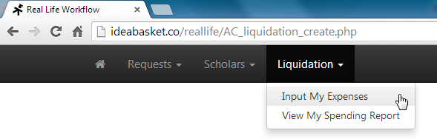
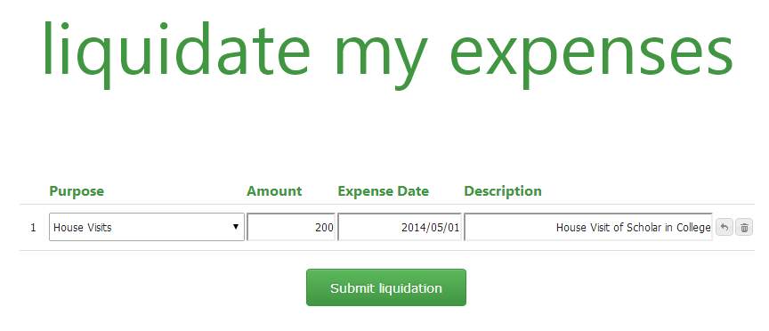
Input Liquidation Expenses:
1
Using the top menu, click ‘Liquidation’ → ‘Input My Expenses’
2
Input the purpose of the expense, the amount, the expense date and any additional comments. Once done, click ‘Submit Liquidation’.

Slide 9
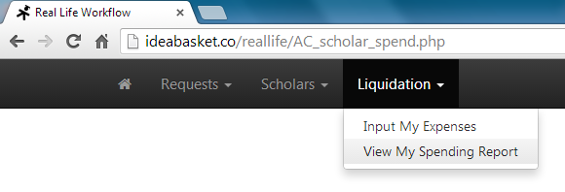
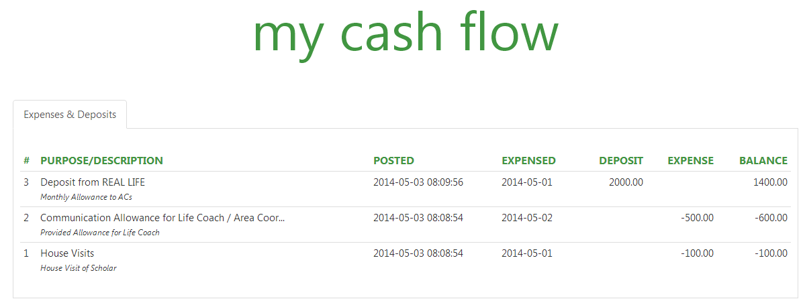
View My Cash Flow:
1
Using the top menu, click ‘Liquidation’ → ‘View My Spending Report’
2
A running cash flow information of all your expenses and all the deposits from real Life will be shown. The most recent transaction will be displayed as the top most entry.

Slide 10
Getting Additional Help:
Contact Real Life Staff
Or contact Web Support at icdlanuza@gmail.com

